Slide 1
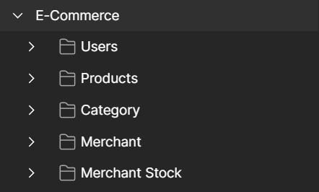

Capstone 1: Spring Boot API Endpoints
Mohammed Alherz
Exploring five advanced RESTful endpoints in a Spring Boot e-commerce project with Postman demonstrations

Slide 2
Introduction
This project extedns the core e-commerce API spring Boot
Five additional endpoints were developed to enhance product interaction, user engagement, and merchant operations
Each endpoint is demonstrated with Postman and explained with backend logic

Slide 3

First Endpoint
01
Best-Selling Product

Slide 4
Best-Selling Product
Description: Retrieves the product with the highest number of purchases.
How it works:
Each product has a timesBought counter.
Every purchase increments the counter.
The endpoint compares all values and return the product with the highest count.

Slide 5
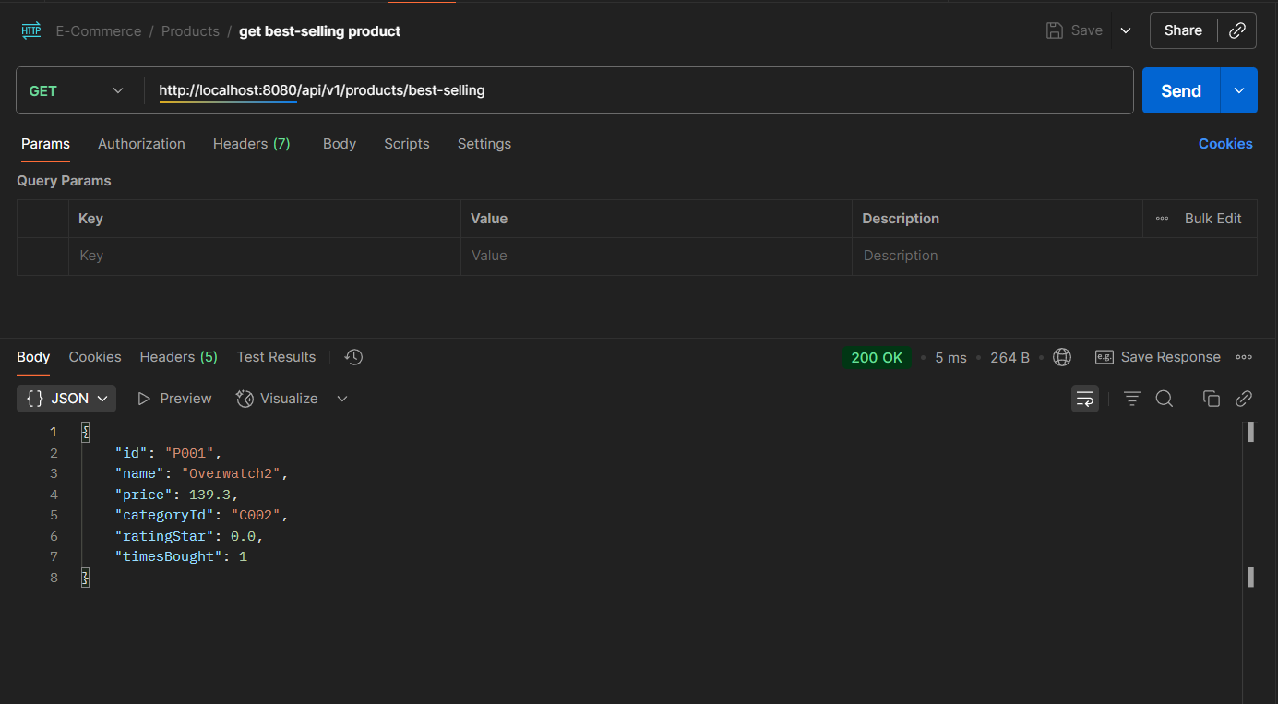
GET /products/best-selling

Slide 6

Second Endpoint
02
Products-by-merchant

Slide 7
Products-by-merchant
Description: Fetches all products related to a specific merchant.
How it works:
Accepts merchantId as path variable.
Calls getAllProductsByMerchant(merchantId).
For each product, it checks if the merchant own the product using merchantHasProduct(merchantId, productid).
Filters and returns only the products that belong to the given merchant.

Slide 8
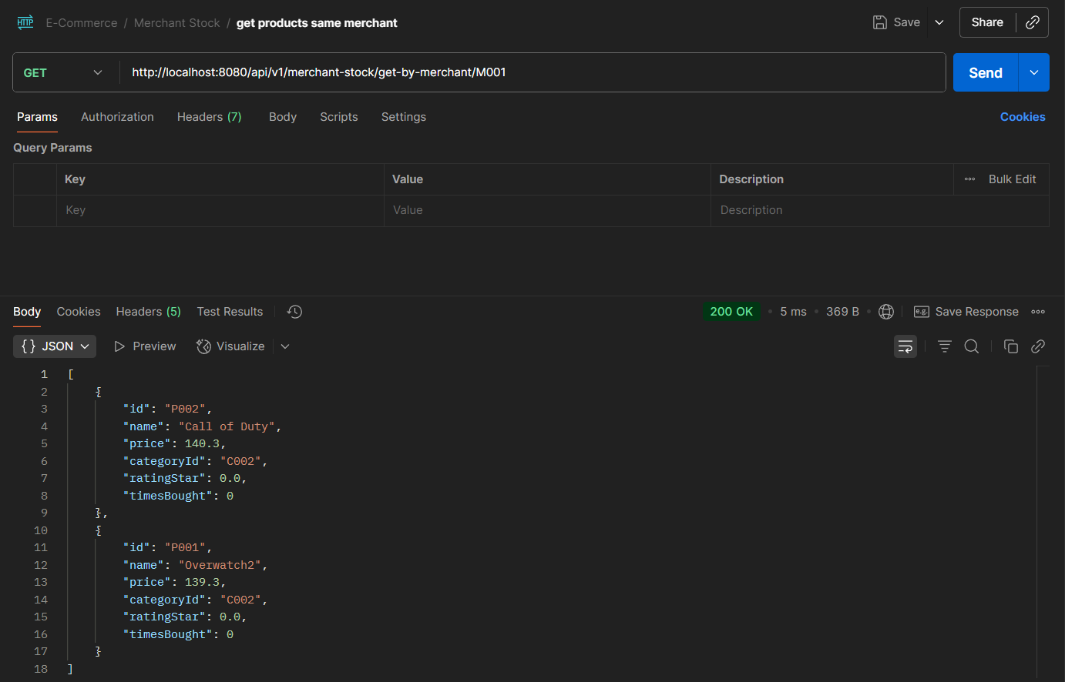
GET /merchant-stock/get-by-merchant/M001

Slide 9
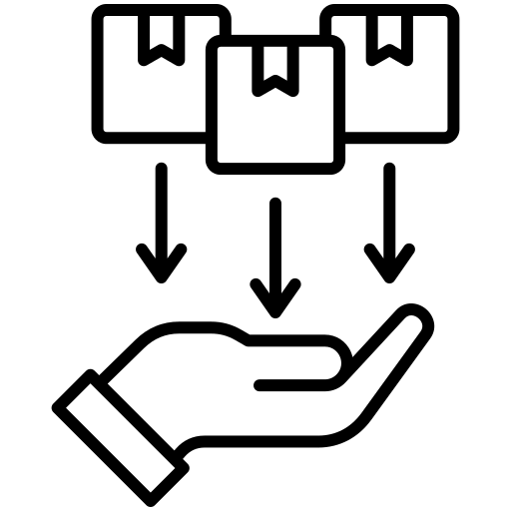
Third Endpoint
03
User's Most-purchased-product

Slide 10
User's Most-purchased-product
Description: Returns the product a specific user has purchased the most
How it works:
Uses a HashMap: userID → (productid → count).
On purchase, count is updated.
When called:
Validate user.
Checks purchase history.
Returns product with highest count.

Slide 11
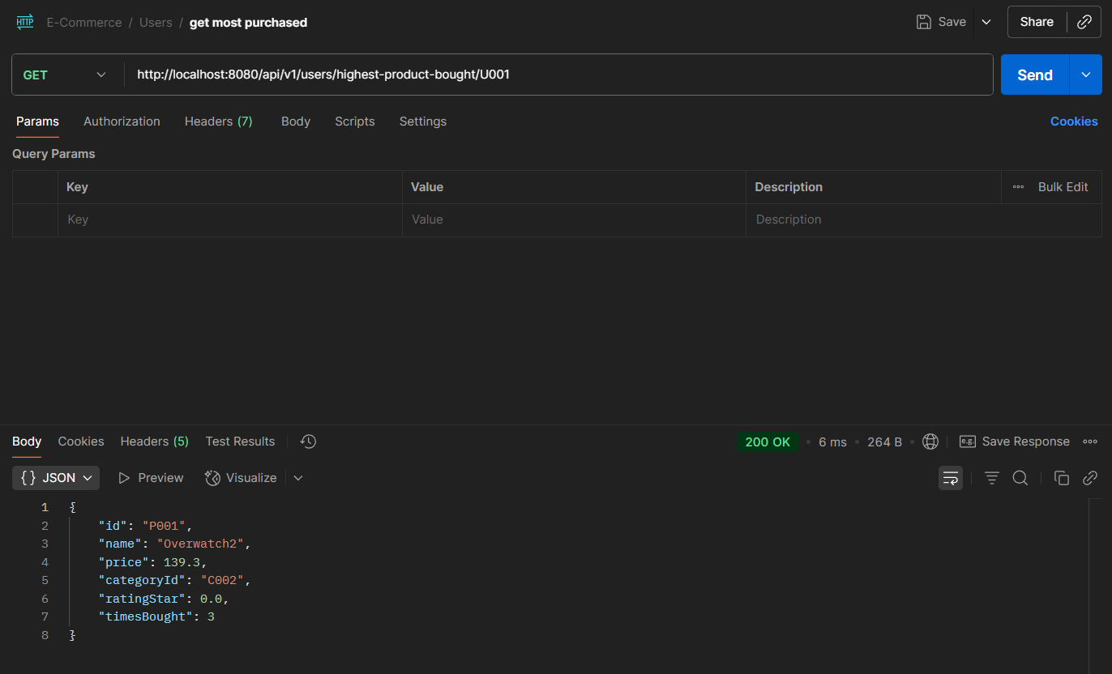
GET /users/highest-product-bought/U001

Slide 12

Fourth Endpoint
04
Rate-product-by-user

Slide 13
Rate-product-by-user
Description: Allos a user to rate a product they’ve purchased.
How it works:
Confirms the user-product pair exist in purchasedCart.
Validates rating(1-5).
Update rating HashMap: productId → (userId → rating).
Recalculates average and updates product.
Validation Rules:
Must be a valid and product.
Purchase required.
Rating must be 1-5.

Slide 14
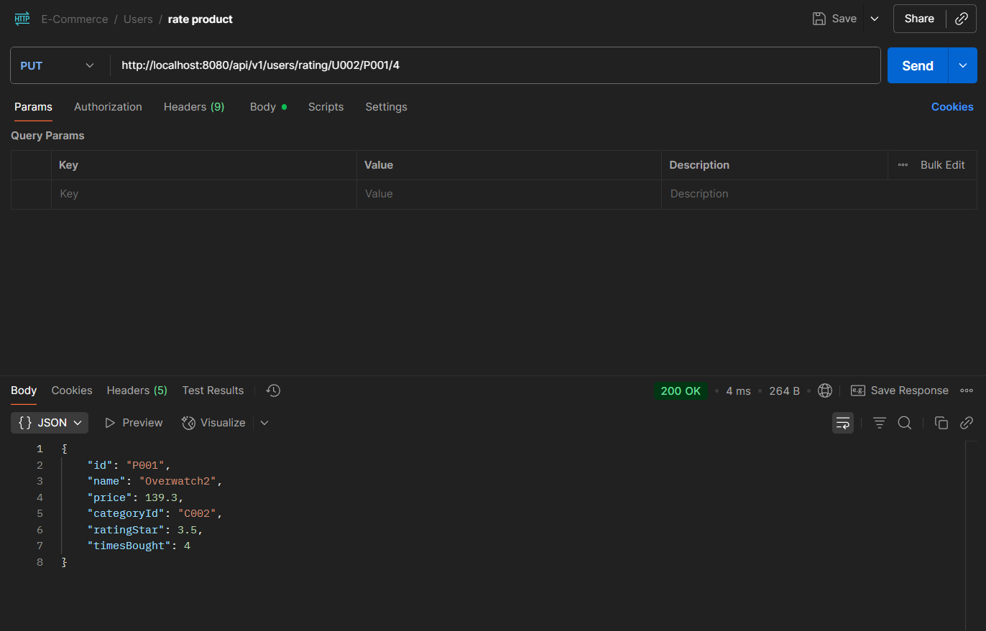
PUT /users/rating/U001/P001/3 PUT /users/rating/U002/P001/4

Slide 15

Fifth Endpoint
05
Refund-product-by-user

Slide 16
Refund-product-by-user
Description: Processes a refund for a purchased product.
How it works:
Checks if user exists.
Verifies product was purchased.
Refunds product price to user’s balance.
Increases merchant’s stock.
Remove record from purchasedCart and userProductMap.

Slide 17
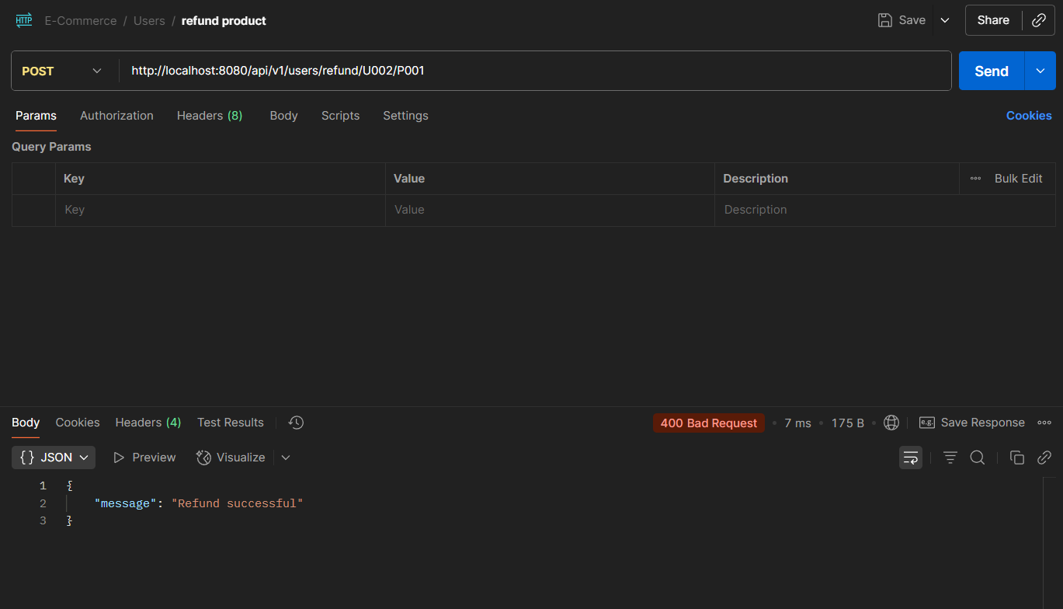
POST /users/refund/U002/P001

Slide 18
Conclusions
These five endpoints add real-world functionality to the API.
They improve the user experience (rating, refunds), support merchants (inventory), and provide analytics (top products).
Each was tested with Postman and validated with custom logic.

Slide 19
Thank you!
Do you have any questions?

